Slide 1
Randolph Public Schools
Steering committee meeting
June 25, 2024

Slide 2
Prior Meeting Review
Overview of 2021 Ag Plans
Cost Estimates for Ag Building
Financial information
Tours
Bond Amount and Tax Impact Survey
Steering Committee Recommendations

Slide 3
Facility Bond Committee Schedule
October 9, 2020: Proposal for Vo Ag Building submitted
March 3, 2021: Owner / Architect contract signed for Vocational Ag Building Design with Fakler Architects
April 16, 2021: Vocational Ag Building design begins
February 4, 2022: Vocational Ag Building design completed
March 17, 2022: Vocational Building bids due. Lone bid received $3,952,100
November 2, 2023: Architect and Construction Manager tour
November 13, 2023 7 PM Board of Education Meeting
December 11, 2023 7 PM Board of Education Meeting
January 3, 2024: Needs assessment with staff and maintenance personnel
January 8, 2024 7 PM Board of Education Meeting
January 30, 2024: Abatement company site visit
February 12, 2024 7 PM Board of Education Meeting
February 26, 2024: Kickoff / Facility Tours – Walk the areas under consideration for bond, review the Facility Audit, share the needs list to date.
March 11, 2024 7 PM Board of Education Meeting
April 4, 2024: Needs Assessment – We will break into small groups and have each group brainstorm a Needs List based on what they saw on the building/facility tours. These will be recorded and compiled into an overall needs list to be used at the next meeting.
Process, Facility Audit Summary, Priority Activity and Survey
April 8, 2024 7 PM Board of Education Meeting
April 18, 2024: Final ranking of Needs List, present financial impact and complete a potential bond $ amount survey the community will support. Cost Estimates for Ag Building will be shared. Additional tours of HS Hallway by PA Gym and Elementary School.
May 13, 2024 7 PM Board of Education Meeting
Week of June 3, 2024 - drawings and narrative due from architect to BD Construction for cost estimating.
June 6 – June 20, 2024: BD Construction cost estimating
June 10, 2024 8 PM Board of Education Meeting
June 25, 2024 7:30 PM: Fakler Architects will present conceptual plans, BD Construction will present costs associated and Northland to present preliminary tax impact.
Preliminary timeline for November election (Tobin)
Discuss additional steering committee meetings/board workshops as necessary
Set date for Public Information Meeting (July 29– Aug 2)
July 8, 2024 8 PM Board of Education Meeting
August 12, 2024 8 PM Board of Education Meeting
Agenda to include: Recommendation by the Building Committee and approval of final Schematic Design and Project Budget by the Board of Education.
Bond election resolution approved by BOE.
September / October: Bond information process including community presentations, website, social media, community coffees, mailers, door knocking, etc. Pre-bond issue election informational sessions by Board of Education, Fiscal Agent, Architect and CM@R.
September 3 last day to add special issue for inclusion on general election ballot.
If resolution isn’t on August board meeting, need special BOE meeting sometime ahead of this date.
September 9, 2024 8 PM Board of Education Meeting
October 14, 2024 8 PM Board of Education Meeting
November 5, 2024: Election Day
November 11, 2024 7 PM Board of Education Meeting

Slide 4
Dates to be Determined
Final Committee Meeting: The goal is to have a generally agreed upon project scope and budget from the committee members. We would also identify a few committee members who are willing to make a recommendation to the school board. This could be in written form or in person at the August Board of Education meeting.
INFORMATION COMMITTEE
Schedule kick-off meeting prior to board calling election (first week in August?)
Invite steering committee members and others to join this group
Northland/BD to introduce the bond information framework
Begin on initial tasks; set next meetings (August)
Northland/BD facilitate committee and district efforts to develop communications package and timeline
Informational website
Social media
Flyers/handouts
Informational mailing
Informational booths at school events
Official informational roll out no later than September 9
Informational efforts should run 6-8 weeks prior to election day on November 5

Slide 5
Bond Amount/Tax Impact Survey

Slide 6
Survey Results
What is the highest bond amount and tax impact you believe the community would support?

Slide 7
Steering Committee Recommendations
New Vocational Building
Middle / Senior High School
Evaluate the extent of structural damage around the existing chimney. Repair/replace decking, insulation, and roofing as needed.
One section of the roof has not been updated. There is currently a leak where the lower roof abuts the original gymnasium. Also, investigate potential mold/roof leak along west wall of north gymnasium.
Add fire sprinklers to cover the entire building.
A/C and fans added in the new gym.
Replace existing lighting with LED throughout building.
Elementary School
Asbestos abatement completed by the school.
Replace HVAC systems.
Add fire sprinklers to the building.
Additional Restrooms
a. Add boy’s on 1st floor
b. Add girl’s on 2nd floor
c. Add in daycare area both boy’s and girl’s
Update existing restrooms; possibly move sinks to hallway.
Replace windows throughout. Existing are single pane, nonthermal, broken aluminum frames. Fewer windows? Bullet resistant?
Replace remaining original lighting with LED.
Reconfigure Main Entrance for security.
Add kitchen in courtyard area north of gym.
Add electrical outlets in classrooms.
KEY
Requires immediate attention pre-bond
Include in bond
Consider in bond
Include in 10-year plan

Slide 8
Project Options
Conceptual ideas + Preliminary cost estimates

Slide 9
Vocational Building

Slide 10
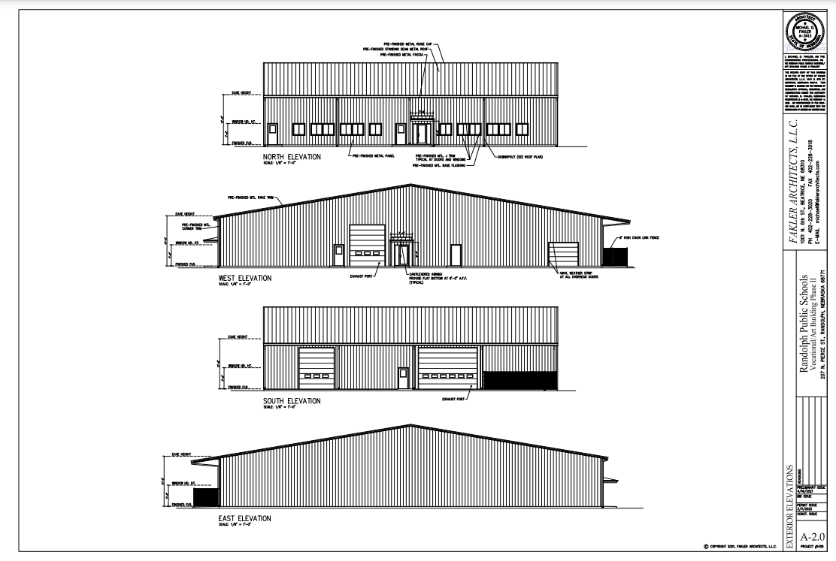

Slide 11
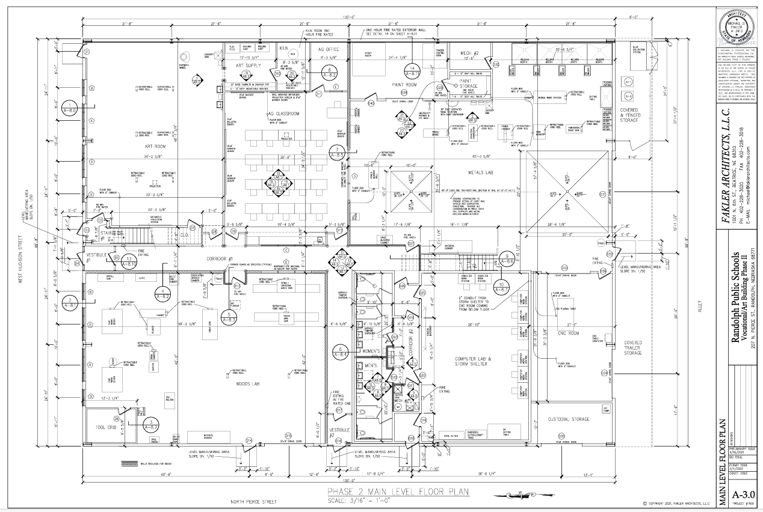

Slide 12
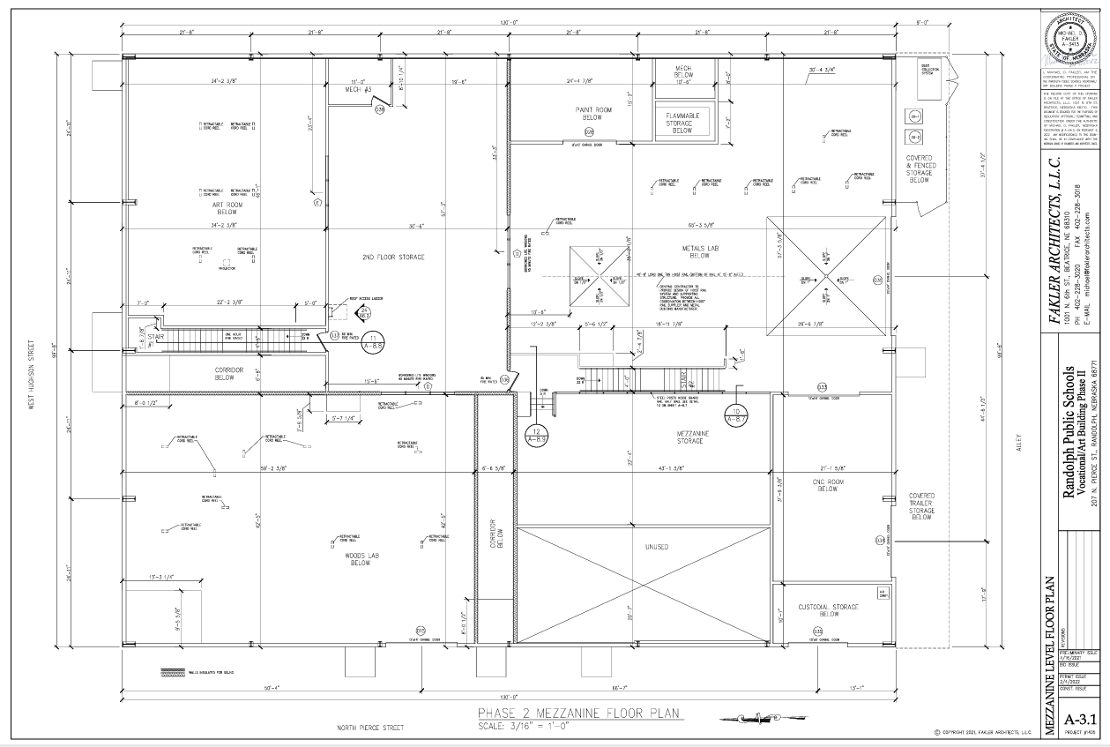

Slide 13
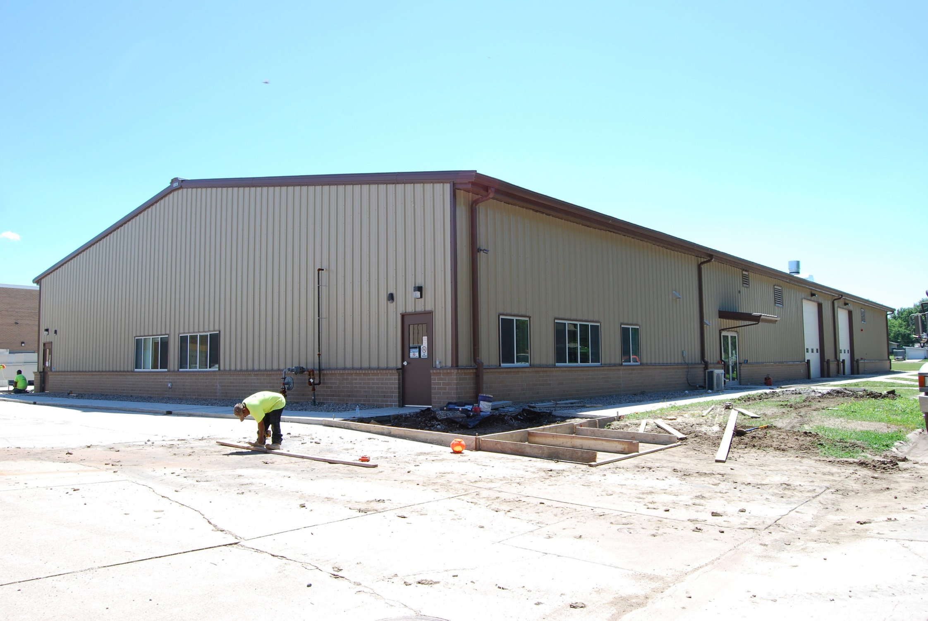

Slide 14
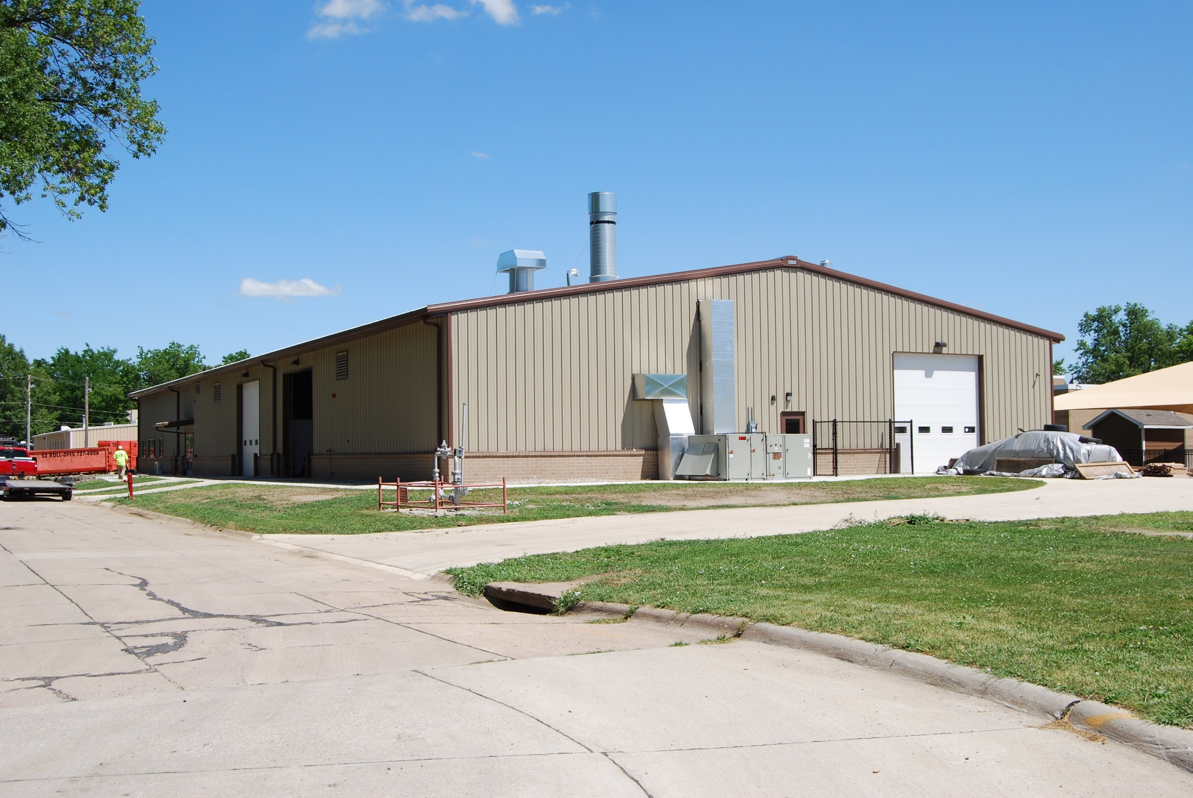

Slide 15
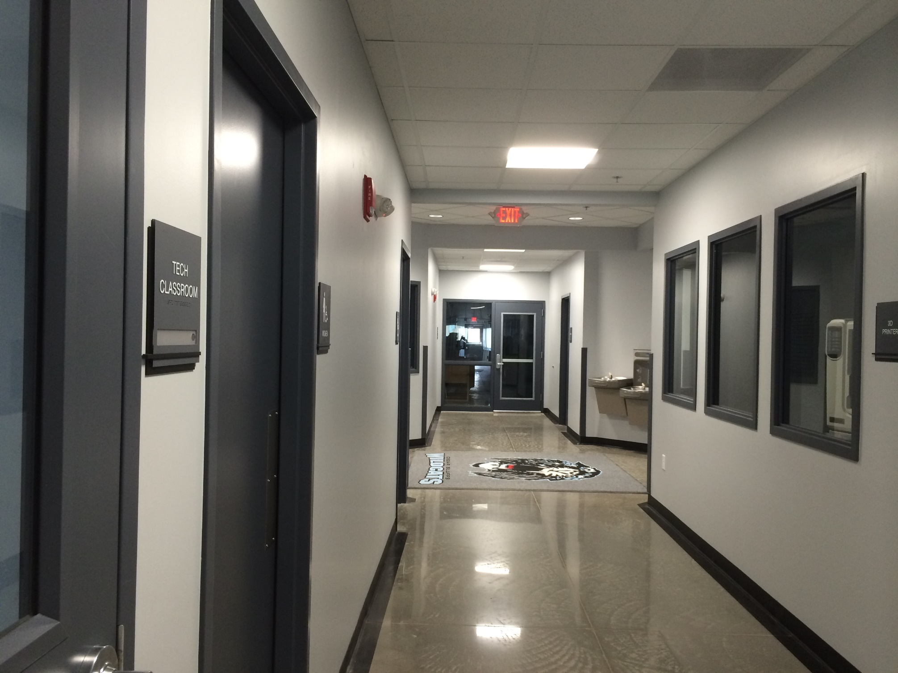

Slide 16
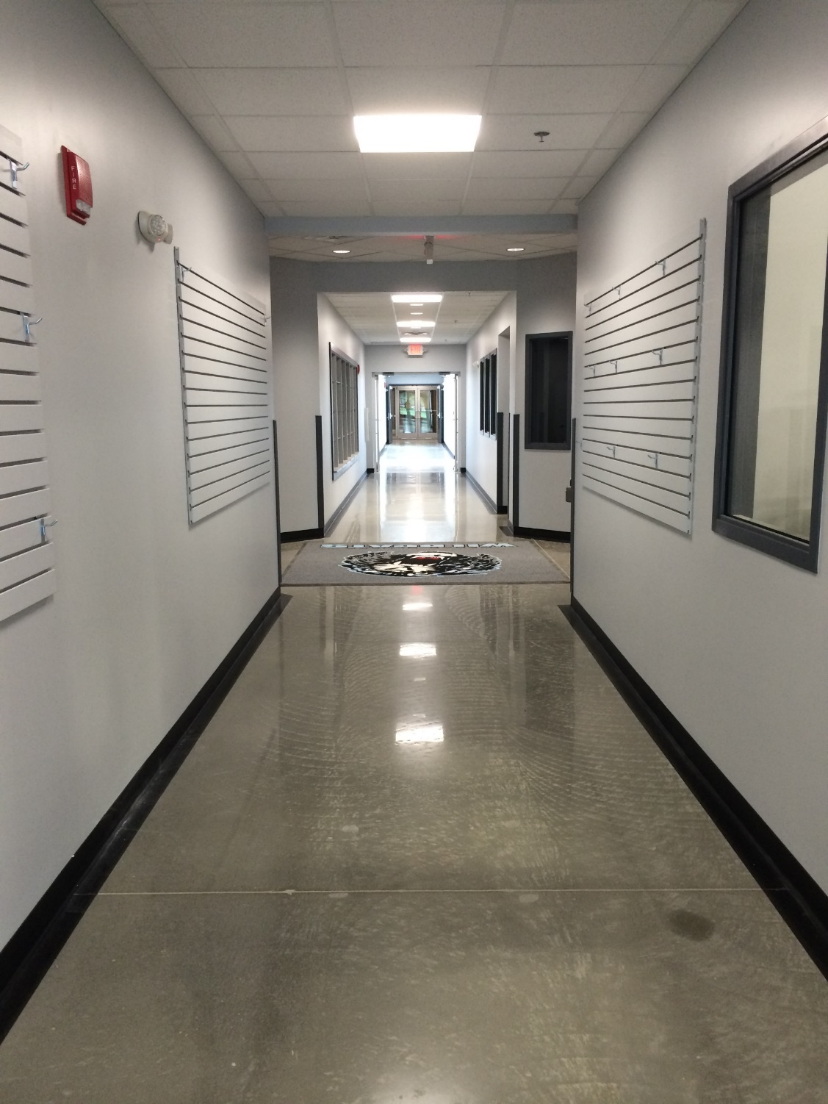

Slide 17
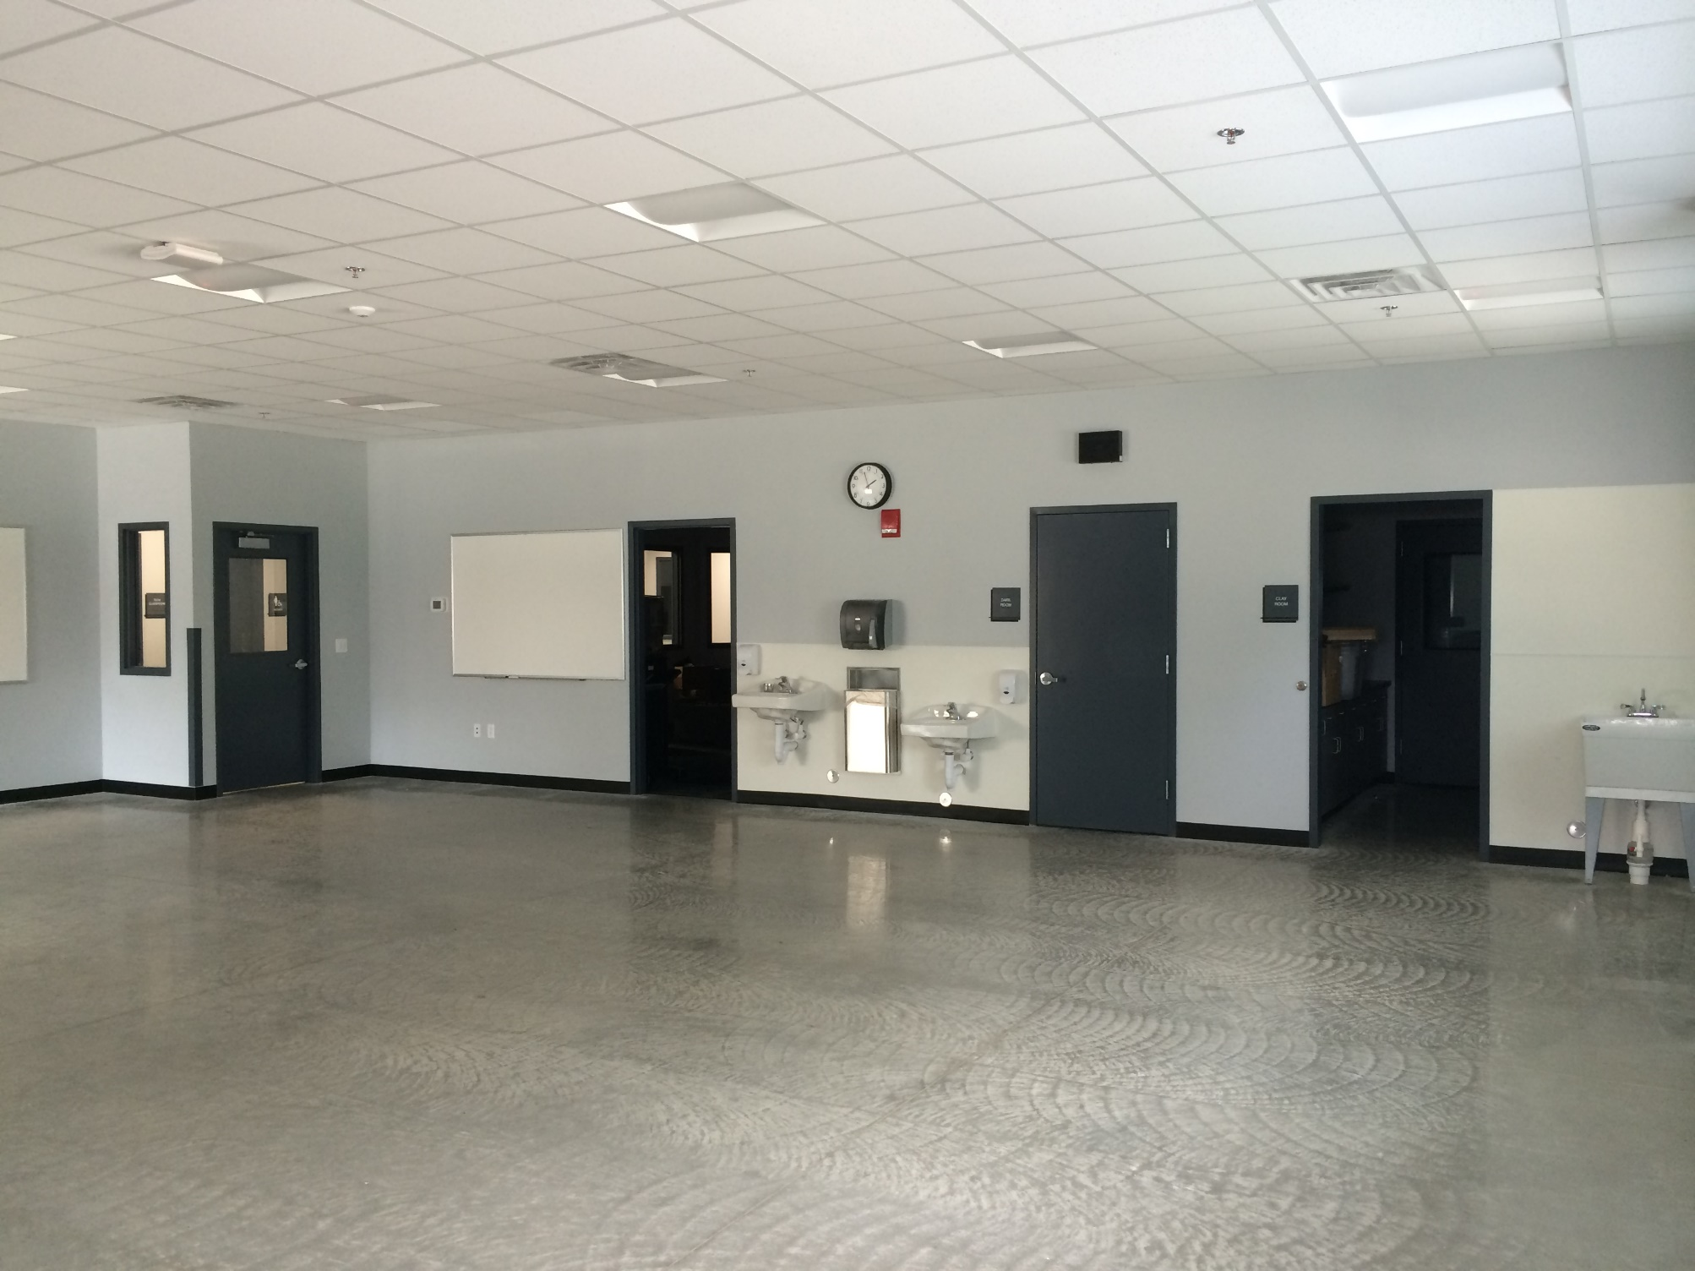

Slide 18
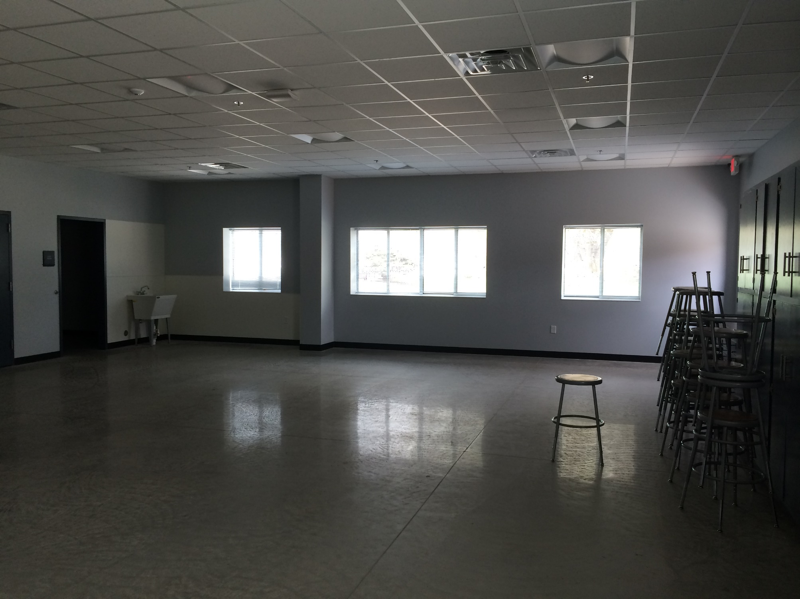

Slide 19
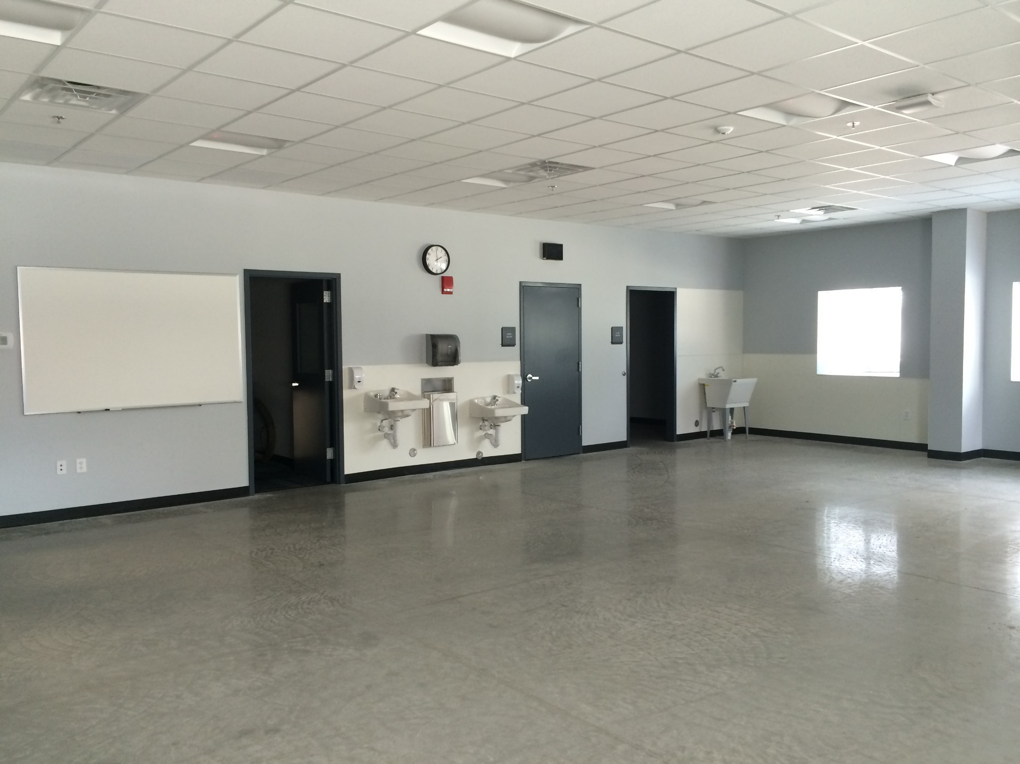

Slide 20
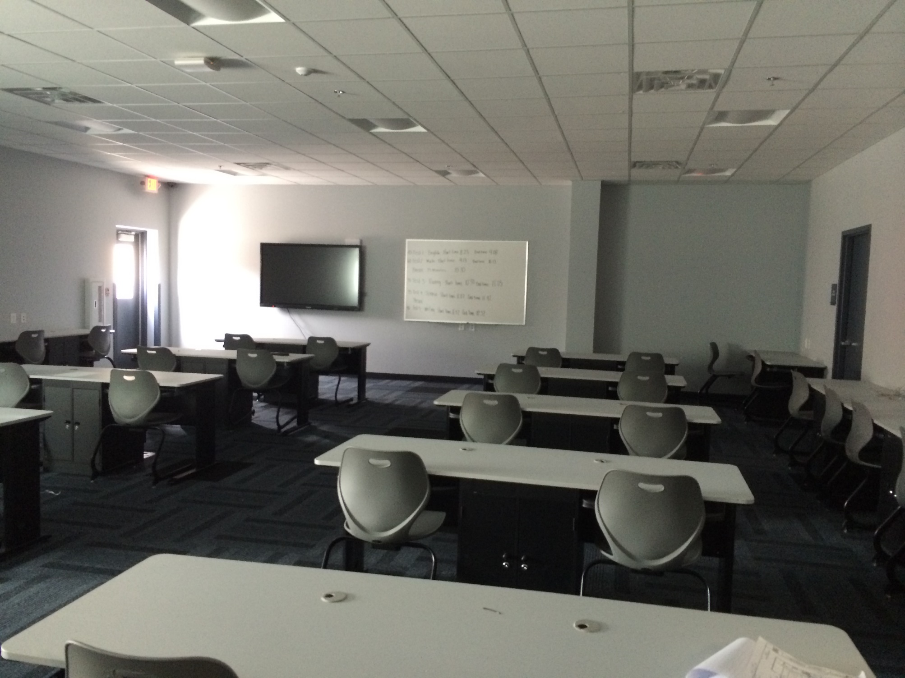

Slide 21
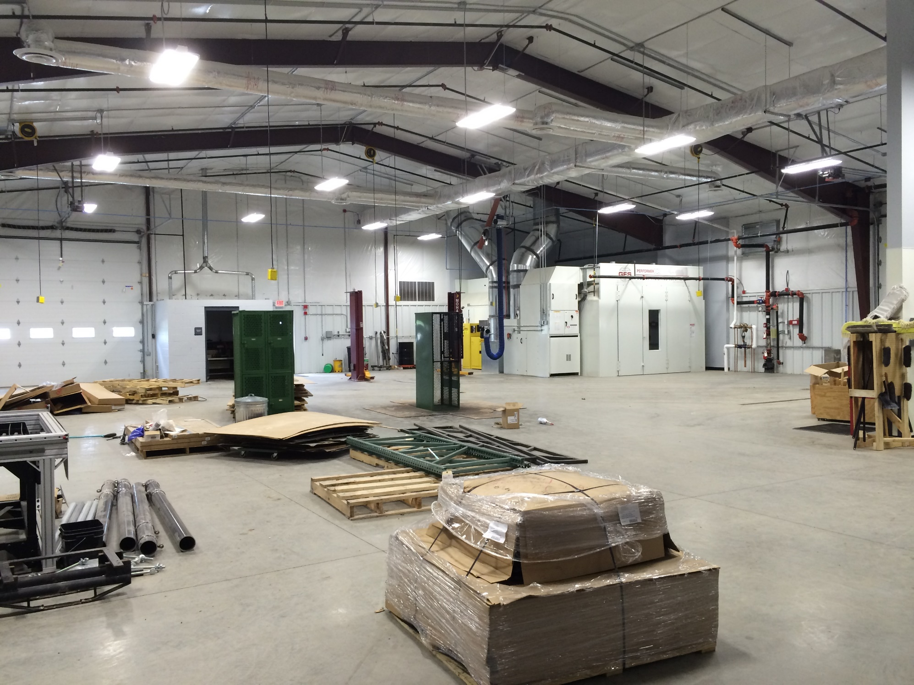

Slide 22
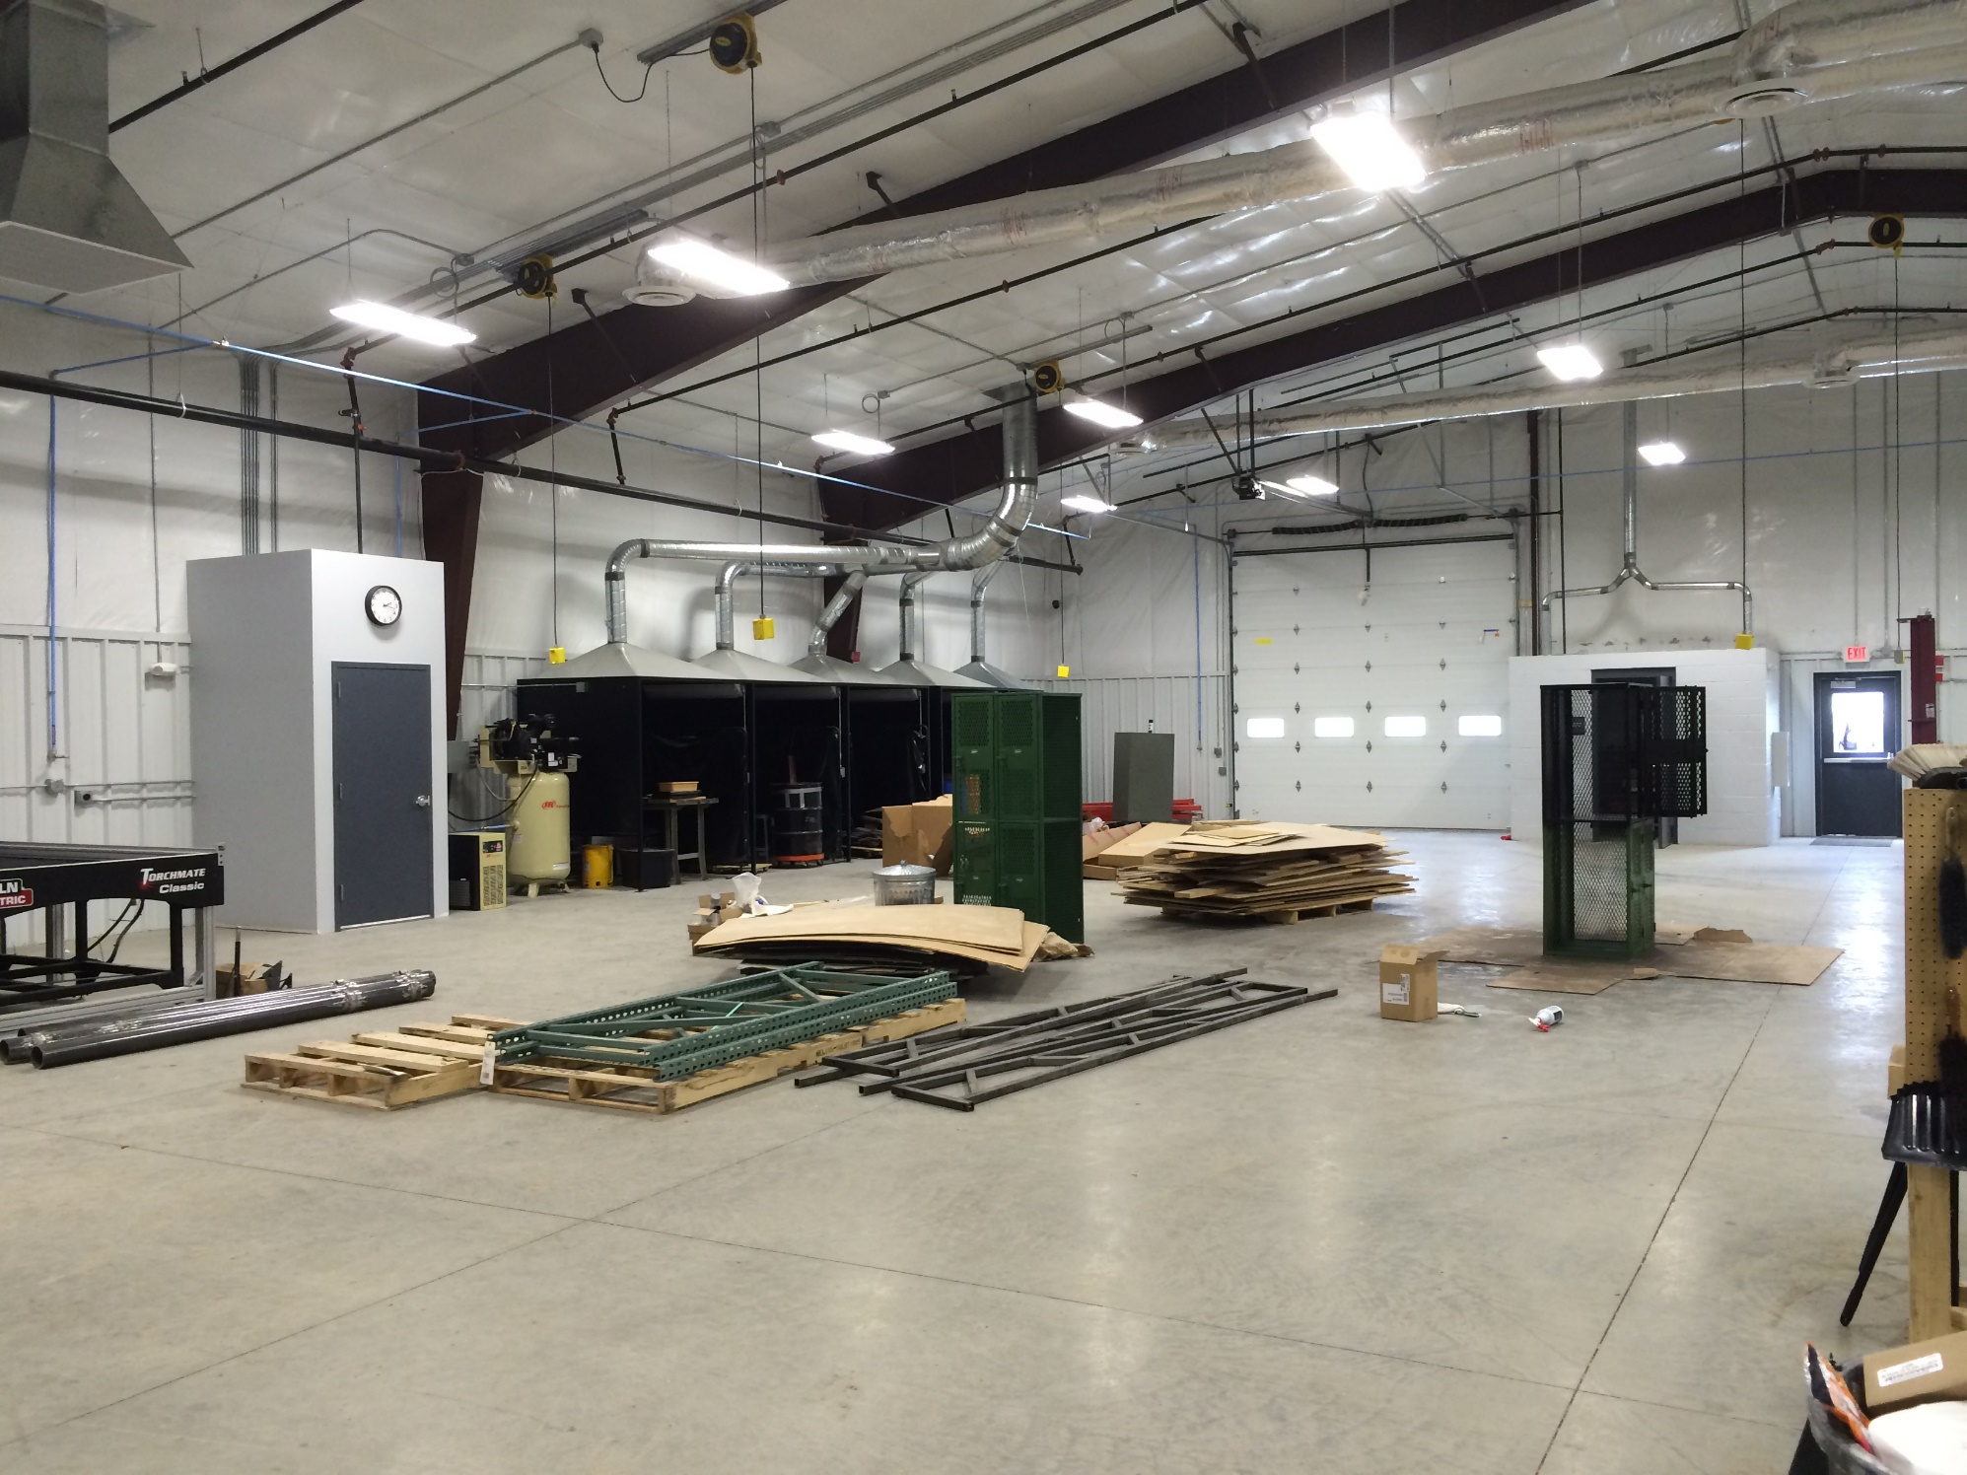

Slide 23
Middle/High School

Slide 24
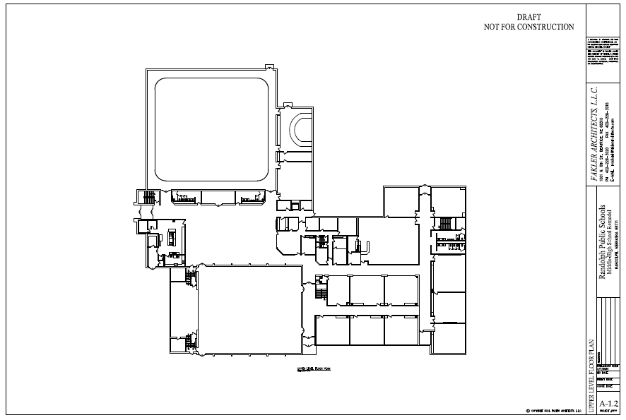

Slide 25
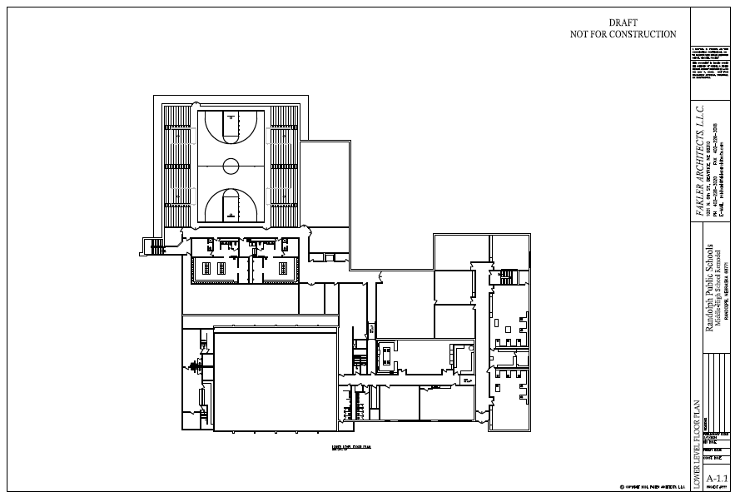

Slide 26
Structural Repairs and Roofing
Objectives
Construction Solutions
Evaluation of structural damage around the chimney
Repair and replacement of decking, insulation, and roofing
Current leak where the lower roof abuts the original gymnasium
Investigation of potential mold/roof leak along west wall of north gymnasium
Replace all damaged decking
Install new sloped insulation system and EPDM roofing
Apply weather barrier to existing gymnasium brick wall
Install rain screen with proper flashings
TBD

Slide 27
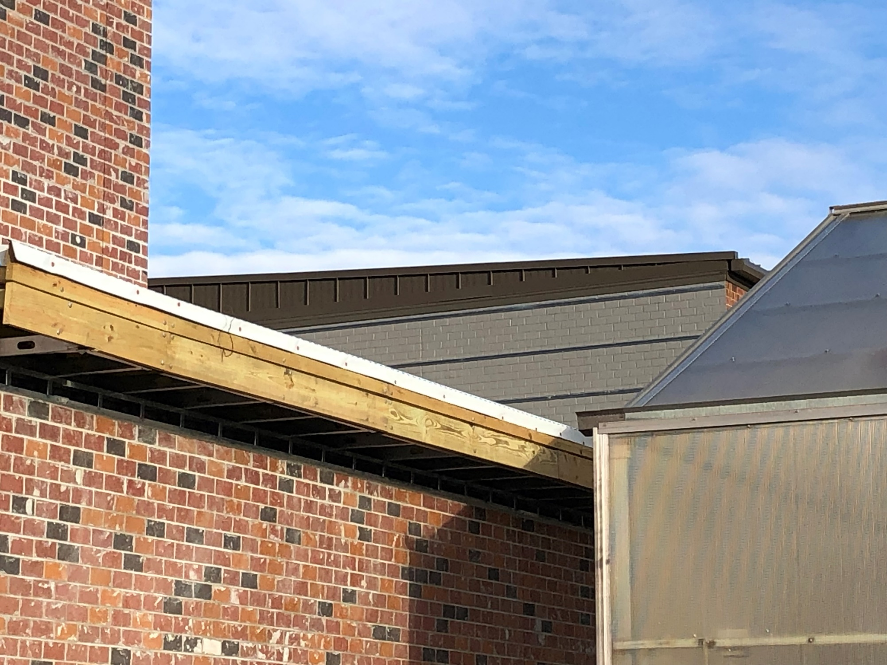

Slide 28
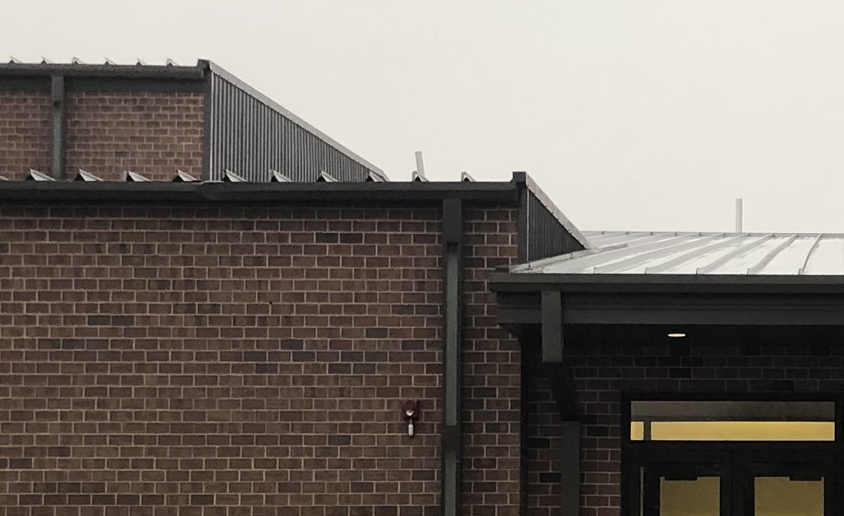

Slide 29
Fire Sprinkler System
Objectives
Construction Solutions
Evaluation of existing fire sprinkler system coverage
Addition of fire sprinklers to cover the entire building
Add to the existing fire sprinkler system to provide complete coverage to the entire building

Slide 30
HVAC and Air Conditioning
Objectives
Construction Solutions
Replace existing air handler units in mechanical room 208
Provide two new air handling units
Reuse existing ductwork when possible
New condensing units
Replace existing relief air fans
Replace damper actuators
Provide CO2 sensers
Upgrade controls
Provide electrical powers required
A/C and fans to be added to the new gym

Slide 31
Lighting Upgrades
Objectives
Construction Solutions
Improve lighting throughout the building
Replace existing lights with equivalent LED lights
Provide emergency battery backup
Provide dimmer switches in classrooms
Provide occupancy sensors

Slide 32
Elementary School

Slide 33
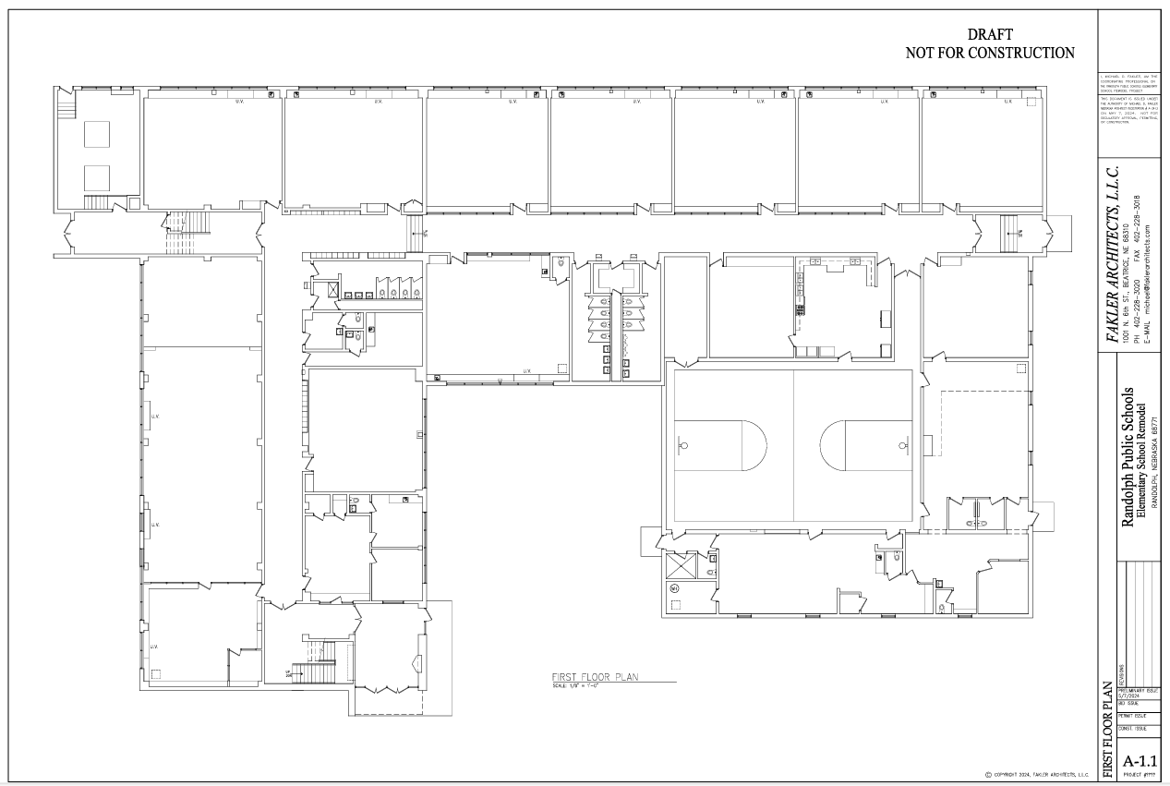

Slide 34
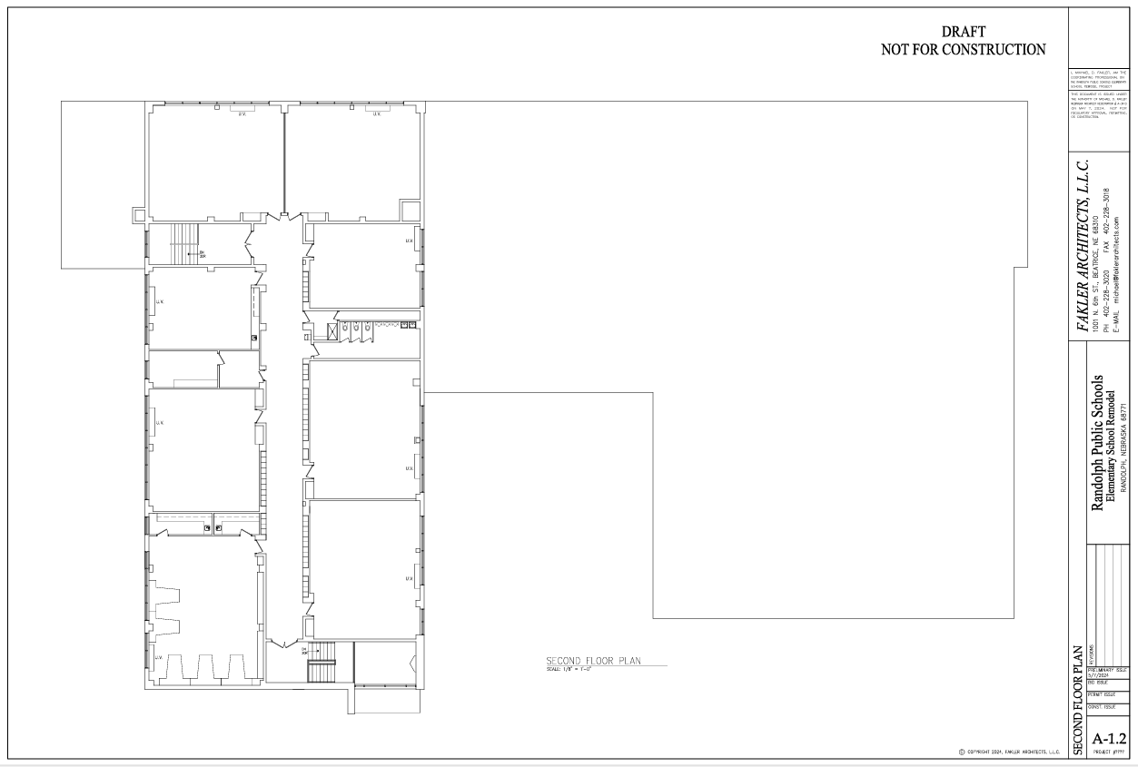

Slide 35
Asbestos Abatement
Objectives
Construction Solutions
Remove all asbestos-containing materials
Environmental Services, Inc. has been contracted to remove hazardous materials

Slide 36
HVAC System Replacement
Objectives
Construction Solutions
Replace HVAC systems
Remove all existing equipment and materials
Install new ducted water-sourced heat pump units
Option 1 – new boiler and chiller system
Option 2 – geothermal well-field system
Electrical service will be upgraded

Slide 37
Fire Sprinklers
Objectives
Construction solutions
Add fire sprinklers to the building
Provide new 4-inch fire sprinkler service
Include backflow preventer and required accessories
Provide connection to fire alarm system as required

Slide 38
Windows
objectives
Construction Solutions
Replace exterior windows
Replace all window with OPTIQ AA5450 series windows by Kawneer with 1 ½” triple glazed tempered glass

Slide 39
Lighting Upgrades
objectives
Construction solutions
Replace existing fluorescent lighting with LED
Install new 2x2 recessed LED troffers
Provide classrooms and library with dimmer switches
Provide emergency battery back-up
Provide occupancy sensors

Slide 40
Electrical Upgrades
objectives
Construction solutions
Add electrical outlets in classrooms
Provide eight surface-mounted receptacles and two new 20-amp circuits per classroom
In the library, provide 10 surface-mounted receptacles and two 20-am circuits

Slide 41
Corridor Ceilings
objectives
Construction solutions
Replaces of corridor ceilings
Remove existing corridor ceilings
Install new 2”x2” mineral fiber suspended ceiling tiles

Slide 42
Restroom Renovations
objectives
Construction solutions
Add boy’s restroom on 1st floor
Demo existing girl’s north restroom and adjacent office uni-sex restrooms and janitor’s closet
Lay out new boy’s and girl’s restrooms
Provide all new fixtures and finishes
Create new janitor’s closet

Slide 43
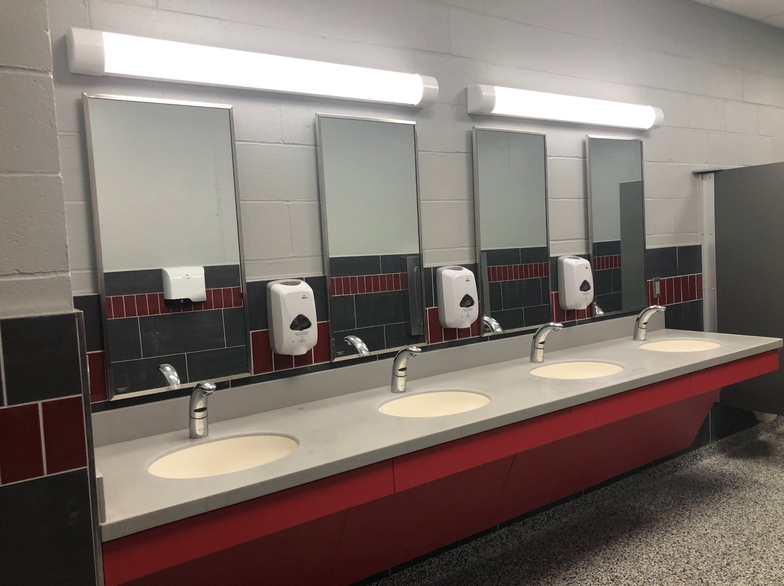

Slide 44
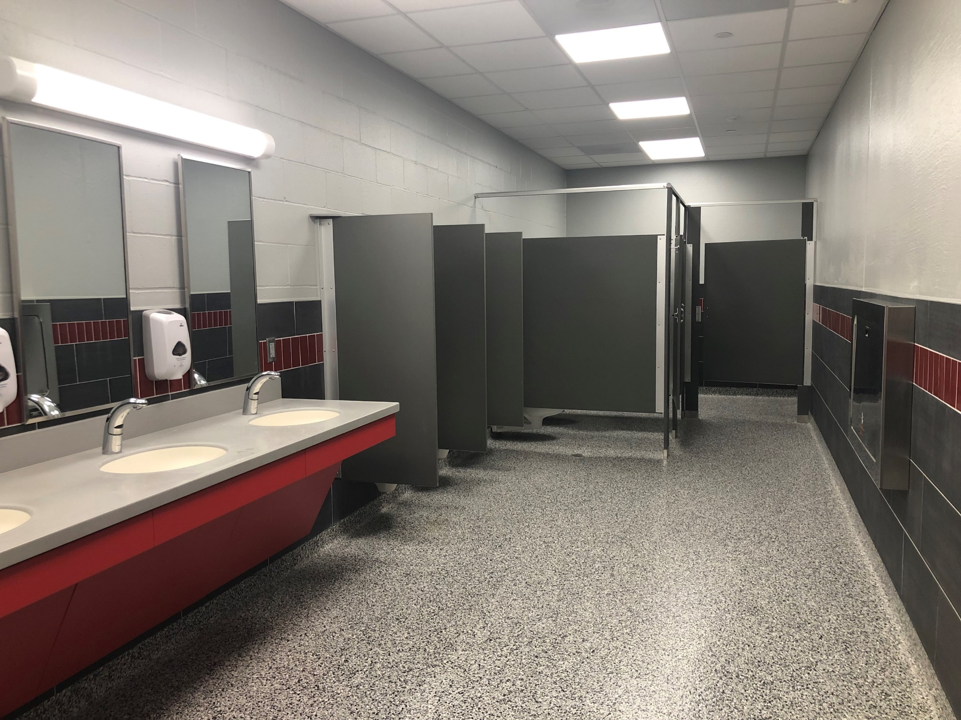

Slide 45
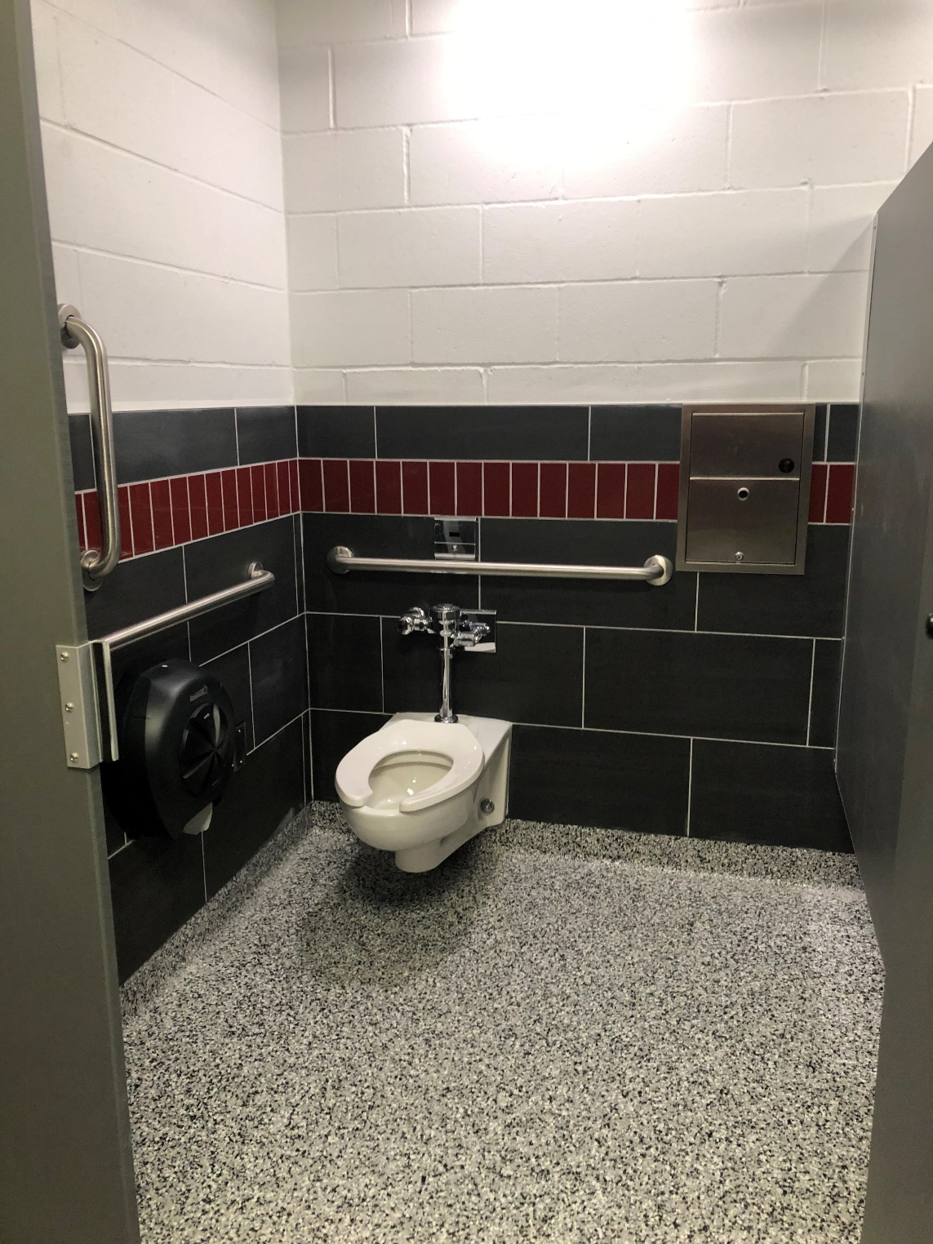

Slide 46
Restroom Renovations, cont.
objectives
Construction solutions
Add girl’s restroom on 2nd floor
Utilize existing classroom east of existing boy’s restroom
Lay out new boy’s and girl’s restrooms
Provide all new fixtures and finishes
Create new janitor’s closet

Slide 47
Restroom Renovations, cont.
objectives
Construction solutions
Add both boy’s and girl’s restrooms in daycare area
Add new addition approximately 300 sq. ft. in size
Addition will provide new boy’s and girl’s restroom with two stall each

Slide 48
Restroom Renovations, cont.
objectives
Construction solutions
Update existing restrooms and possibly move sinks to hallway
Gut and reconfigure south restrooms on first floor to match new north restrooms

Slide 49
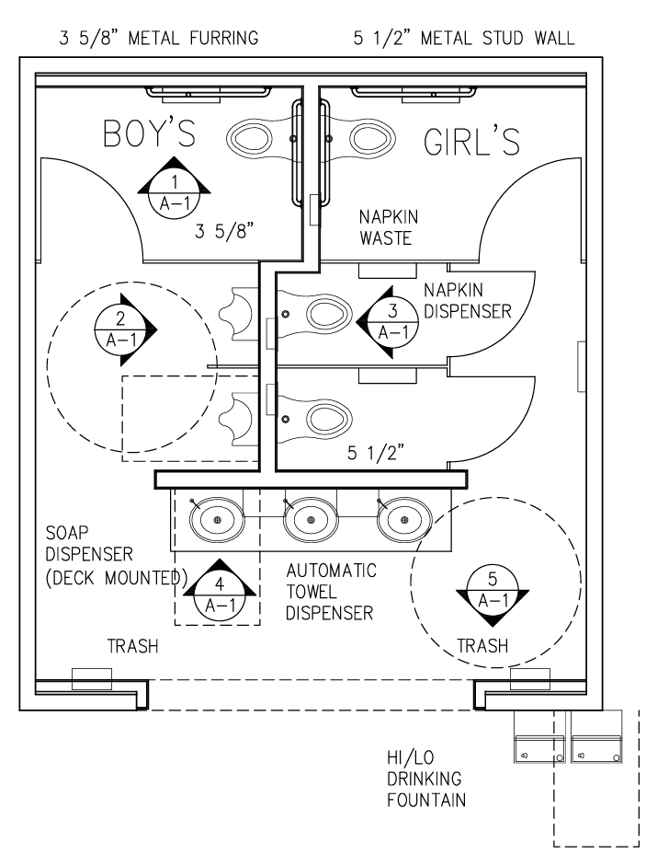

Slide 50
Main Entrance Security
Objectives
Construction solutions
Reconfiguration of main entrance for improved security
Remove existing handicap entry and fill opening
Remove pairs of existing doors and replace with ADA compliant doors
Replace borrowed-light window and principal’s and secretary’s office
Provide security pass-through at secretary’s window
Provide new security door to corridor
Provide cameras and intercom system
Provide steel bollards

Slide 51
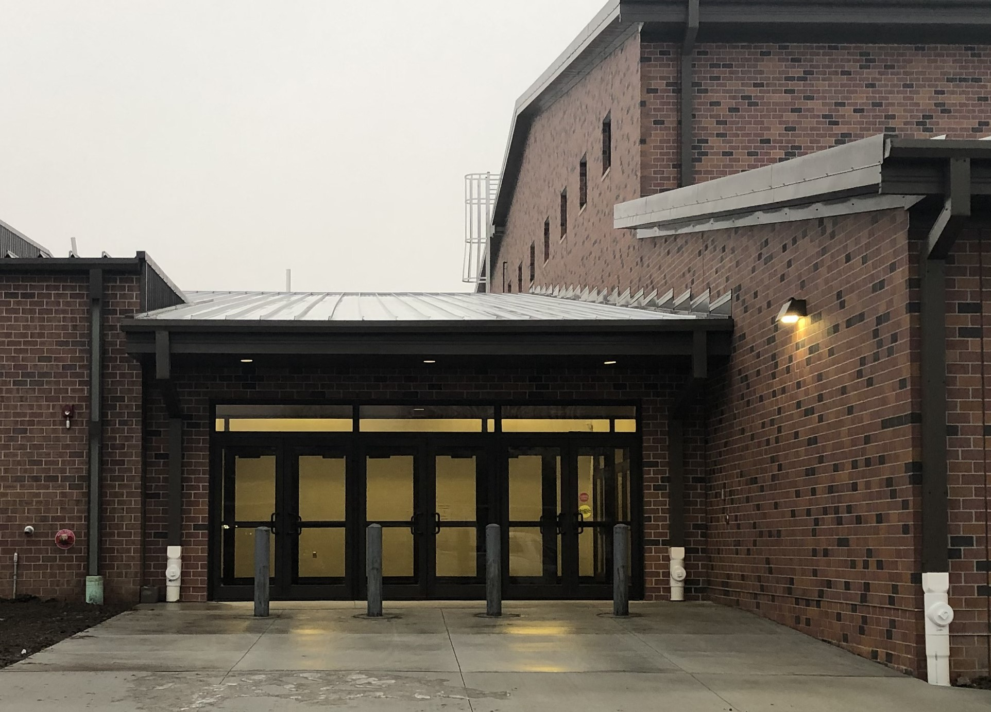

Slide 52
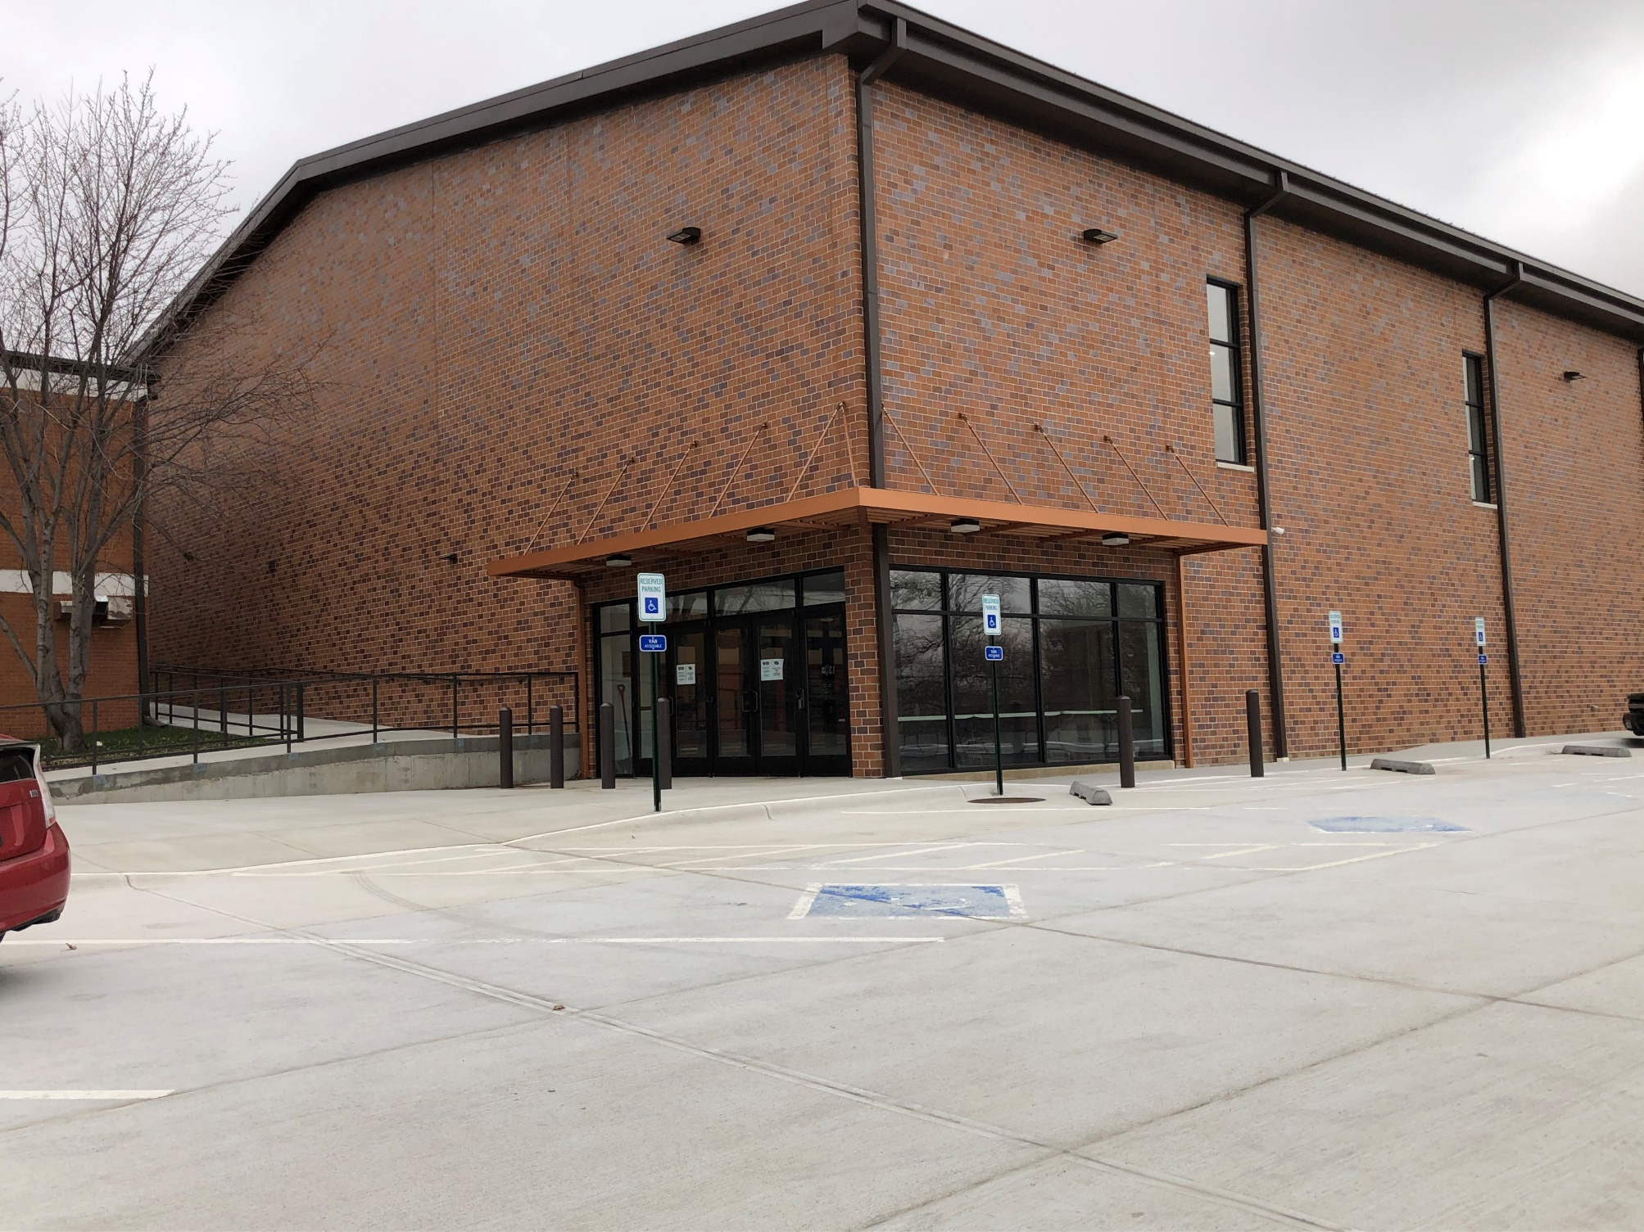

Slide 53
Kitchen Addition
objectives
Construction solutions
Add kitchen in courtyard area north of gymnasium
Add slab-on-grade addition, approximately 1650 sq. ft.
Utilize ICF structure with light-gage metal roof trusses
Addition will contain a kitchen, pantry, general storage, and mechanical room

Slide 54
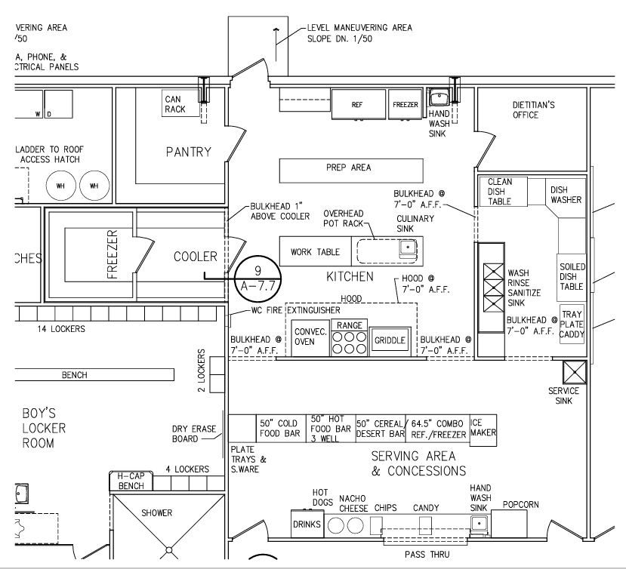

Slide 55
Construction Estimates

Slide 56
Preliminary Cost Estimates
Vocational Ag. Building $5,236,377.83
Mid/HS Building $1,346,000.00
Elementary Building $6,234,875.00
TOTAL $12,817,252.83

Slide 57
Tax Impact
Conceptual ideas + Preliminary cost estimates

Slide 58
Bond Issue Impact (Preliminary)
$12,800,000 Par Amount @ 20 years (around 4.40%)
Bond tax levy impact = 15.3 cents/$100 of valuation
$100,000 of property = $153 increase per year
Avg. Irrigated Acre = $6.37 increase per year
Avg. Irrigated Quarter = $1,019 increase per year

Slide 59
Bond Issue Impact (Preliminary)
$9,000,000 Par Amount @ 20 years (around 4.40%)
Bond tax levy impact = 11 cents/$100 of valuation
$100,000 of property = $110 increase per year
Avg. Irrigated Acre = $4.57 increase per year
Avg. Irrigated Quarter = $731 increase per year

Slide 60
Bond Issue Impact (Comparison)
$9,000,000 Bond $12,800,000 Bond
11 cent bond levy 15.3 cent bond levy
$110 per $100,000 $153 per $100,000
$4.57 per irrigated acre $6.37 per irrigated acre
$731 per irrigated quarter $1,019 per irrigated quarter
*Information is reflected as annual impacts and would be multiplied times the number of years the bond would be outstanding if no refunding or early pay off occurs.

Slide 61
Bond Information Process
Community+District informing voters

Slide 62
NOVEMBER 2024 TIMELINE
JULY/AUG 2024 Steering Committee/Board Meetings
Consensus on project scope
AUG BOE Mtg: Election Resolution Approved By Board (can be done at Special BOE meeting)
SEPT 3, 2024: Signed resolution to election commissioner
AUG/SEPT 2024: Information Process
Information committee established
Initial information framework meeting
Define information committee roles/tasks
SEPT/OCT 2024: Website/Social Media/Small Group Outreach Meetings/Information booths at school events/
Information Brochures to Households/Public Information Forum(s)
NOVEMBER 5, 2024: ELECTION DAY
Notes:
Verify various dates…

Slide 63
General Questions to Answer
What is needed ?
Why is this needed?
Why now?
How much can we afford?
Community input?

Slide 64
Election Timetable
Compact information process 6-8 weeks prior to election day
Information should build and peak right before Election Day
Focus on community informational meetings (small group outreach/public meeting) as well as previously scheduled school and community events
Final informational efforts last 10 days before election day to inform voters and encourage participation

Slide 65
Information Process Organization
Information Committee
Brochure design
FAQs
Project Benefits
Finance Section
Newspaper Ads
Website design/content
Email contact list
Develop information contact pieces
Voter Contact Committee
Registered voter list
‘Inform’ every voter
GOTV
Information Booths
Voter Registration Drive
Message/ Content Committee

Slide 66
Keys To Success
CREATE STRONG TEAM
KNOW YOUR PROJECT
LAY THE GROUNDWORK
IDENTIFY THE ISSUES
PROVIDE CLEAR/COMPELLING INFORMATION

